Slide 1


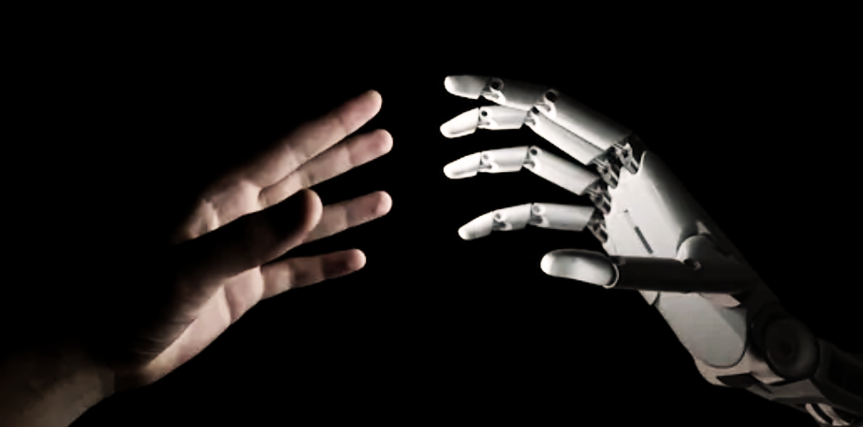
GESTURE RECOGNITION AND COUNTER

Slide 2
ABSTRACT
Hand gesture recognition system has developed excessively in the recent years reason being its ability to cooperate with machine successfully.
Gestures are considered as the most natural way for communication among humans and PCs in virtual framework earlier we use hand gestures for non verbal communication with people but now we can also use hand gestures to communicate with machines.
This project is to implement human computer interaction. based on machine leaning domain. This project is implemented with OpenCV and with help of python. In this project computer recognizes the gestures and shows the data what we are performing.

Slide 3
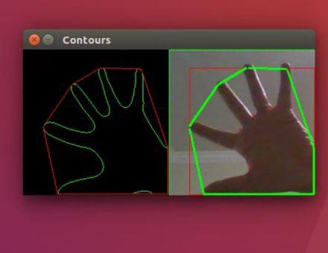
PROPOSED SYSTEM
Most gesture recognition methods usually contain three major stages .
The first stage is the object detection. The target is to detect hand objects in the digital images or videos.
The second stage is to do object recognition . The detected hand objects are recognised to identify the gestures . At this stage, differentiated features and effective classifiers selection are a major issues in most researchers.
The third stage is to analyse sequential gestures to identify users instructions or behaviour.

Slide 4
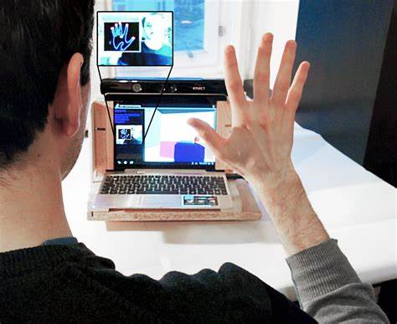
EXISTING SYSTEM
In recent decades,due to computer software and hardware technologies of continuous innovation and breakthrough , the social life and information technology have a very close relationship.
The traditional electronic input devices such as mouse,keyboard and joysticks are still the most common interaction way.However it doesn’t mean that these devices are the most convenient and natural input devices for most users.
Since ancient times,gestures are a major way for communication an interaction between people.
People can easily express the idea by gestures still are naturally used by many people and especially are the major and nature interaction way for deaf people.

Slide 5

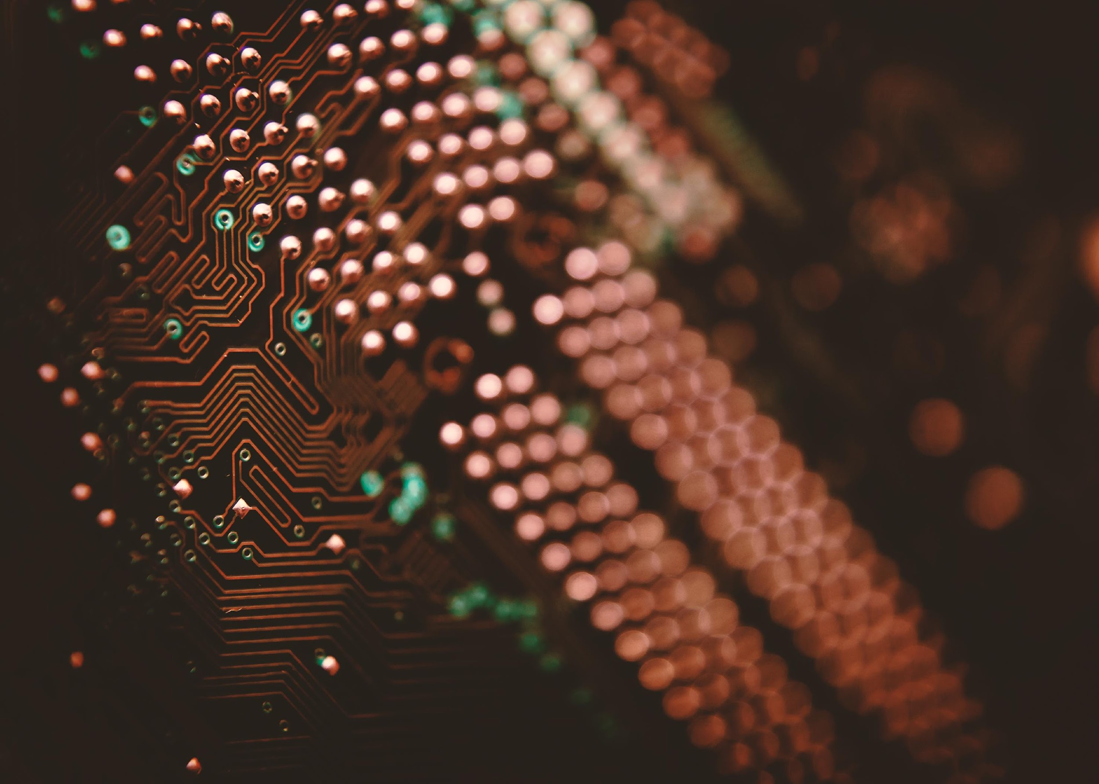


COMPUTING COMPONENTS
Window10
Intel® Pentiun® CPU N3710@1.60GHz
64-bit operating system,x64-based processor
8GB RAM
Web cam
NVIDIA GeForce
Python-3x
OpenCV-4.5
MediaPipe-0.8.5
Tensorflow-2.5.0
Numpy-1.19.3
SOFTWARE COMPONENTS
HARDWARE COMPONENTS

Slide 6
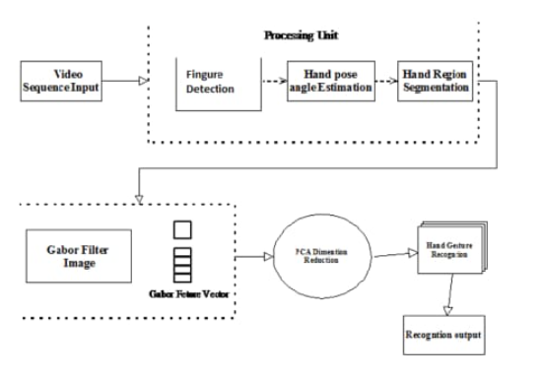
ARCHITECTURE

Slide 7
STRENGHTS:
WEAKNESSES:
This method is an industry trend and gesture recognition market’s rising trends aid up and coming forms in differentiating themselves in this integrated industry sector.
There are many leading praticipants in this sector like leading companies like:
Qualcomm Technologies Inc(USA)
Intel Corporation(U.S)
Google Inc(U.S)
Apple Inc(U.S)
SWOT
OPPURTUNITIES:
THREATS:
Gesture recognition involves voice recognition ,facial recognition,lip movement,eye tracing and others.
This Technology also increased in health care for training and examining.
There is a growing demand of gesture recognition technology in gaming industry.
As mentioned in weaknesses,There are many leading companies who work on this technology.By this the market is led by these giants and they dominate the market.Hence the market is consolidated.Therefore market concentration is high.

Slide 8
Python code:
import cv2
import numpy as np
import math
cap = cv2.VideoCapture(0)
while(1):
try:
ret, frame = cap.read()
frame=cv2.flip(frame,1)
kernel = np.ones((3,3),np.uint8)
roi=frame[100:300, 100:300]
cv2.rectangle(frame,(100,100),(300,300),(0,255,0),0)
hsv = cv2.cvtColor(roi, cv2.COLOR_BGR2HSV)
# define range of skin color in HSV
lower_skin = np.array([0,20,70], dtype=np.uint8)
upper_skin = np.array([20,255,255], dtype=np.uint8)
#extract skin colur imagw
mask = cv2.inRange(hsv, lower_skin, upper_skin)

Slide 9
#extrapolate the hand to fill dark spots within
mask = cv2.dilate(mask,kernel,iterations = 4)
#blur the image
mask = cv2.GaussianBlur(mask,(5,5),100)
#find contours
contours,hierarchy= cv2.findContours(mask,cv2.RETR_TREE,cv2.CHAIN_APPROX_SIMPLE)
#find contour of max area(hand)
cnt = max(contours, key = lambda x: cv2.contourArea(x))
#approx the contour a little
epsilon = 0.0005*cv2.arcLength(cnt,True)

Slide 10
approx= cv2.approxPolyDP(cnt,epsilon,True)
#make convex hull around hand
hull = cv2.convexHull(cnt)
#define area of hull and area of hand
areahull = cv2.contourArea(hull)
areacnt = cv2.contourArea(cnt)
#find the percentage of area not covered by hand in convex hull
arearatio=((areahull-areacnt)/areacnt)*100

Slide 11
#find the defects in convex hull with respect to hand
hull = cv2.convexHull(approx, returnPoints=False)
defects = cv2.convexityDefects(approx, hull)
# l = no. of defects
l=0
#code for finding no. of defects due to fingers
for i in range(defects.shape[0]):
s,e,f,d = defects[i,0]
start = tuple(approx[s][0])

Slide 12
end = tuple(approx[e][0])
far = tuple(approx[f][0])
pt= (100,180)
# find length of all sides of triangle
a = math.sqrt((end[0] - start[0])**2 + (end[1] - start[1])**2)
b = math.sqrt((far[0] - start[0])**2 + (far[1] - start[1])**2)
c = math.sqrt((end[0] - far[0])**2 + (end[1] - far[1])**2)
s = (a+b+c)/2

Slide 13
ar = math.sqrt(s*(s-a)*(s-b)*(s-c))
#distance between point and convex hull
d=(2*ar)/a
# apply cosine rule here
angle = math.acos((b**2 + c**2 - a**2)/(2*b*c)) * 57
# ignore angles > 90 and ignore points very close to convex hull(they generally come due to noise)
if angle <= 90 and d>30:
l += 1
cv2.circle(roi, far, 3, [255,0,0], -1)

Slide 14
# ignore angles > 90 and ignore points very close to convex hull(they generally come due to noise)
if angle <= 90 and d>30:
l += 1
cv2.circle(roi, far, 3, [255,0,0], -1)
#draw lines around hand
cv2.line(roi,start, end, [0,255,0], 2)
l+=1

Slide 15
#print corresponding gestures which are in their ranges
font = cv2.FONT_HERSHEY_SIMPLEX
if l==1:
if areacnt<2000:
cv2.putText(frame,'Put hand in the box',(0,50), font, 2, (0,0,255), 3, cv2.LINE_AA)
else:
if arearatio<12:
cv2.putText(frame,'0',(0,50), font, 2, (0,0,255), 3, cv2.LINE_AA)
elif arearatio<17.5:
cv2.putText(frame,'Best of luck',(0,50), font, 2, (0,0,255), 3, cv2.LINE_AA)

Slide 16
else:
cv2.putText(frame,'1',(0,50), font, 2, (0,0,255), 3, cv2.LINE_AA)
elif l==2:
cv2.putText(frame,'2',(0,50), font, 2, (0,0,255), 3, cv2.LINE_AA)
elif l==3:
if arearatio<27:
cv2.putText(frame,'3',(0,50), font, 2, (0,0,255), 3, cv2.LINE_AA)
else:
cv2.putText(frame,'ok',(0,50), font, 2, (0,0,255), 3, cv2.LINE_AA)

Slide 17
if arearatio<27:
cv2.putText(frame,'3',(0,50), font, 2, (0,0,255), 3, cv2.LINE_AA)
else:
cv2.putText(frame,'ok',(0,50), font, 2, (0,0,255), 3, cv2.LINE_AA)
elif l==4:
cv2.putText(frame,'4',(0,50), font, 2, (0,0,255), 3, cv2.LINE_AA)
elif l==5:
cv2.putText(frame,'5',(0,50), font, 2, (0,0,255), 3, cv2.LINE_AA)

Slide 18
elif l==6:
cv2.putText(frame,'reposition',(0,50), font, 2, (0,0,255), 3, cv2.LINE_AA)
else :
cv2.putText(frame,'reposition',(10,50), font, 2, (0,0,255), 3, cv2.LINE_AA)
#show the windows
cv2.imshow('mask',mask)
cv2.imshow('frame',frame)
except:
pass
k = cv2.waitKey(5) & 0xFF
if k == 27:
break
cv2.destroyAllWindows()
cap.release()

Slide 19

ADVANTAGES
Gestures allow the user to handle multiple points of input and even define several parameters at once.
Unlike traditional buttons and menus, gestures do not interrupt the user's activity by forcing him to move his hand to the location of a command. Instead, they can be performed directly from the current cursor position.
Also, they do not require any additional devices: the command and even its parameters can be specified by a simple hand movement.
Gestures feel very natural to perform since they mirror our experiences in the real world.

Slide 20

DISADVANTAGES
Gesture-based interfaces have many advantages and provide the user with a completely new form of interaction. However, this kind of input also raises issues that are not relevant with traditional input.
On the user's side, these problems are to learn, to remember and to accurately execute gestures.
The developer has to provide a system that correctly recognizes these gestures.

Slide 21
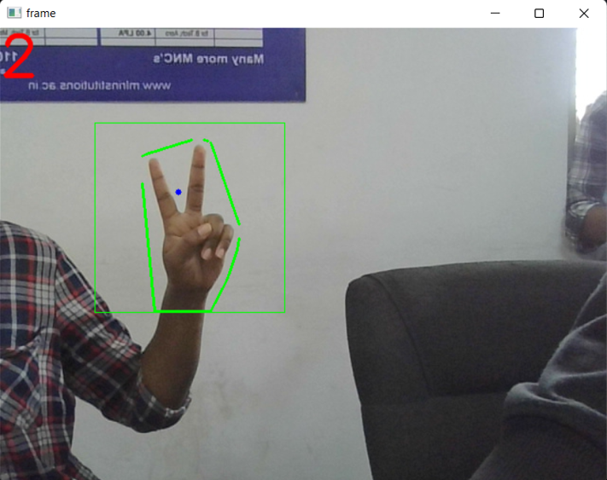
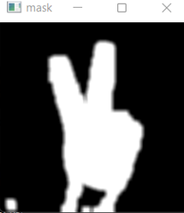
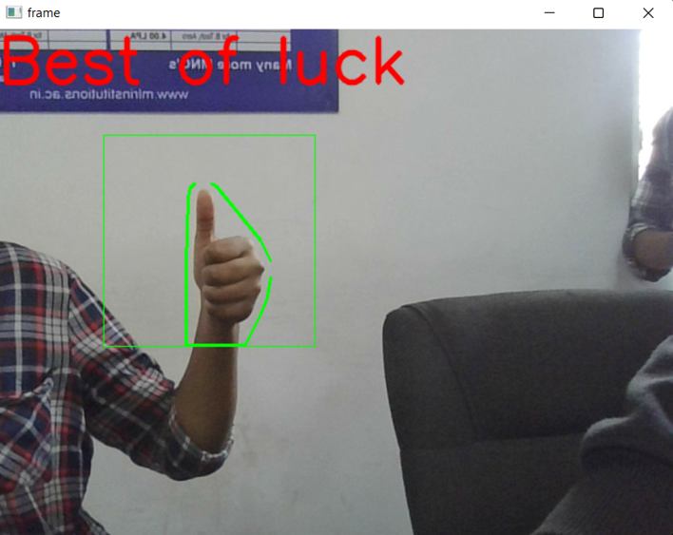
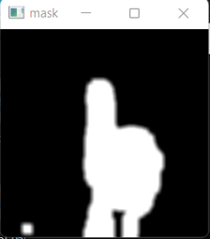
RESULT

Slide 22

CONCLUSION
Our aim is to improve human-machine interaction.
Hand gestures provides an interesting interaction in a variety of computer applications.
If this is built then this can be a beginning for building a robot .
In case a situation like if robots need to understand gestures and need to respond ,at that instance this is used.

Slide 23


